Slide 1
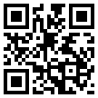
TIME TO RACE!
Help us win with the
most bike trips!
Join
by scanning
the QR code
Record
your bike trips
during May
PRIZES!
Weekly $25 Tango gift card winners
Grand Prize $50 Tango gift card
COMMUTEPA.ORG
1.866.579.RIDE
Find us on social media for more ways to win!

